Slide 1
Prediction and Investigation of Cancerous Metastasis Gene Expression Data through Machine Learning Methods
Mathias Byskov Nielsen
201506038
Projects in Bioinformatics
Bioinformatics Research Centre

Slide 2
Project: Learning goals
The student should be able to describe the investigated topic “Cancer of unknown primary” and the following dataset which relates to the topic from a biological and a statistical point of view.
The student should be able to analyze and implement appropriate statistical models that helps and support the overall goal of the project. Here both basic and more advanced statistical tests/models can be explored (eg. hypothesis tests, machine learning approaches).
The student should be able to discuss the obtained results and hereby the reasoning behind the chosen approaches for dealing with the topic.
The student should be able to evaluate whether or not the project has yielded satisfying results. Also, future aspects or different approaches for dealing the issue can be discussed.

Slide 3
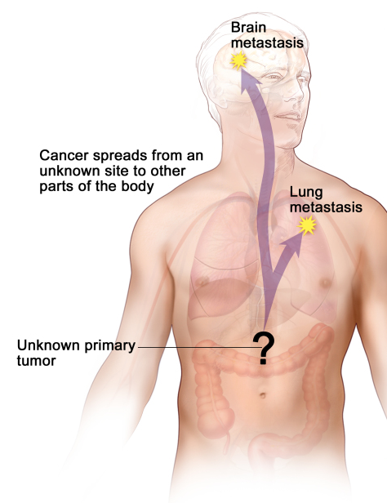
Cancer of Unknown Primary (CUP)
The situation where a cancerous tumor is confirmed histologically, but regular tools fails to identify the primary origin of the site¹
Identification¹
Histologically confirmation, that the tumor is distinct from surrounding tissue
The tissue where it originated remains unknown.
Accounts for 3-5% of all tumors with a median survival rate of 6 months²

Slide 4
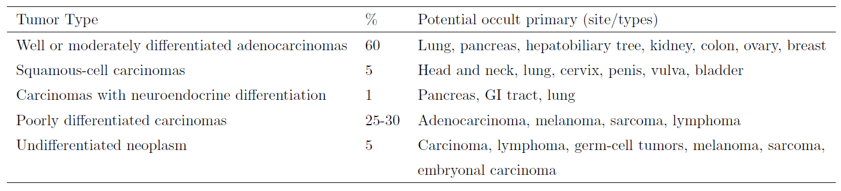
CUP: Treatment & Future research
Standard approach for treatment: Classify the CUP into 5 distinct morphological subtypes, based on light microscopy and IHC staining³
New era: Using molecular profiling: DNA-sequencing, gene-expression and epigenetics. Previous studies have yielded results with an accuracy of 82-97%⁴.

Slide 5
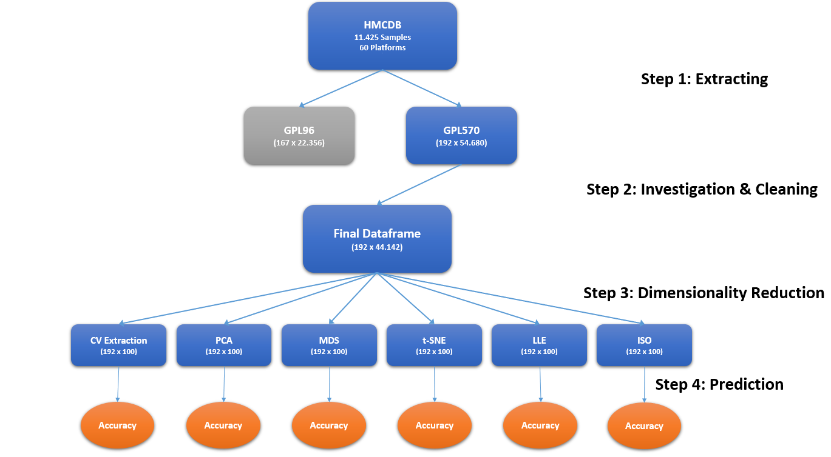
Project workflow

Slide 6
Project workflow

Slide 7
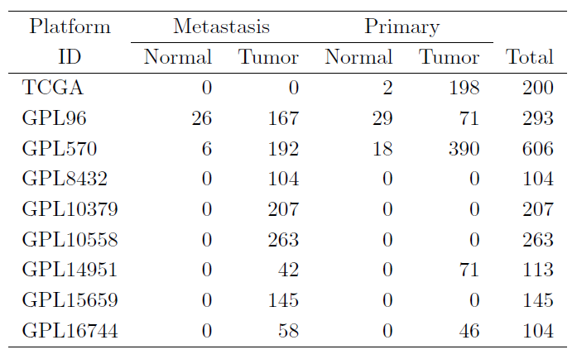
Human Cancer metastasis database
HCMDB is the first public database providing published cancer metastasis expression profiles⁵
Collection of RNA sequencing & microarray profiles
Derived from;
NCBI Gene Expression Omnibus (GEO)
Sequences Read Archive (SRA)
The Cancer Genome Atalas (TCGA)
11.425 samples from 60 platforms
Samples with >100 samples

Slide 8
Human Cancer metastasis database
HCMDB is the first public database providing published cancer metastasis expression profiles⁵
Collection of RNA sequencing & microarray profiles
Derived from;
NCBI Gene Expression Omnibus (GEO)
Sequences Read Archive (SRA)
The Cancer Genome Atalas (TCGA)
11.425 samples from 60 platforms
Samples with >100 samples

Slide 9
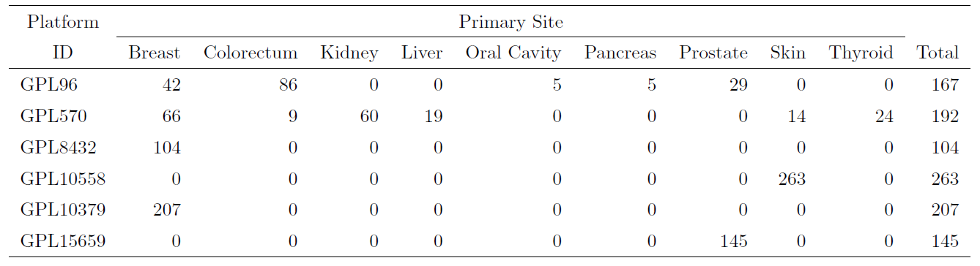
Human cancer metastasis database
Primary site investigation of the 6 platforms
Highly skewed (only two platforms contain multiple primary sites)
Two candidate platforms (GPL96 & GPL570)

Slide 10
Human cancer metastasis database
Primary site investigation of the 6 platforms
Highly skewed (only two platforms contain multiple primary sites)
Two candidate platforms (GPL96 & GPL570)

Slide 11
Step 1: extraction
GPL96 & GPL570 were extracted using GEOparse
Two (n x m) datasets:
GPL96 (167 x 22.356)
GPL570 (192 x 54.680)

Slide 12
Step 2: Investigation & cleaning
GPL70 & GPL570 are extremely high-dimensional (p >> n)
All columns with missing values are dropped
New datasets:
GPL96: (167 x 18.259)
GPL570: (192 x 44.142)
Merging?

Slide 13
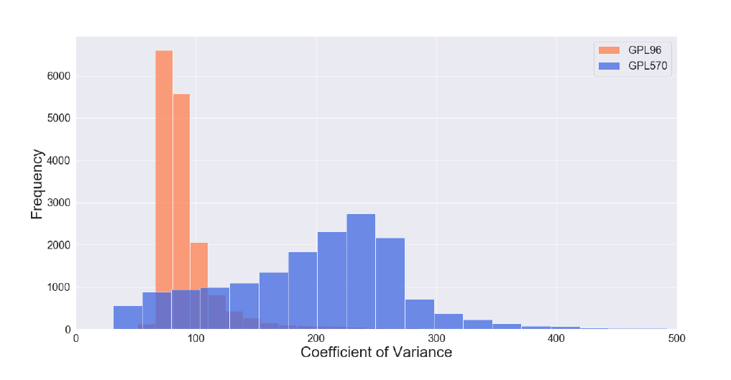
Step 2: investigation & Cleaning
Great interest in increasing the sample-size (n)
All 6 original platforms was extracted in order to identify merge-able platforms
GPL96 + GPL570 were the only to merge-able datasets
359 x 16.662
Is the merge valid/trustworthy?

Slide 14
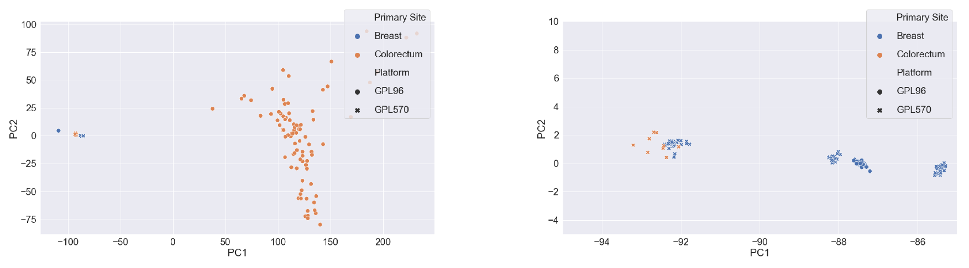
Step 2: investigation and cleaning
PCA plot over merged dataset for only ‘breast’ and ‘colorectum’ samples:

Slide 15
Step 3: dimensionality reduction

Slide 16
Step 3: dimensionality reduction
Dimensionality Reduction: GPL570 was reduced to 192 x 100 using different methods
Feature Selection:
CV-EXT: Taking the 100 features with highest CoV-scores.
Feature Extraction:
PCA: Principal Component Analysis
MDS: Multidimensional Scaling
t-SNE: t-distributed stochastic neighbor embedding
LLE: Locally Linear Embedding
ISO: Isometric Feature Mapping

Slide 17
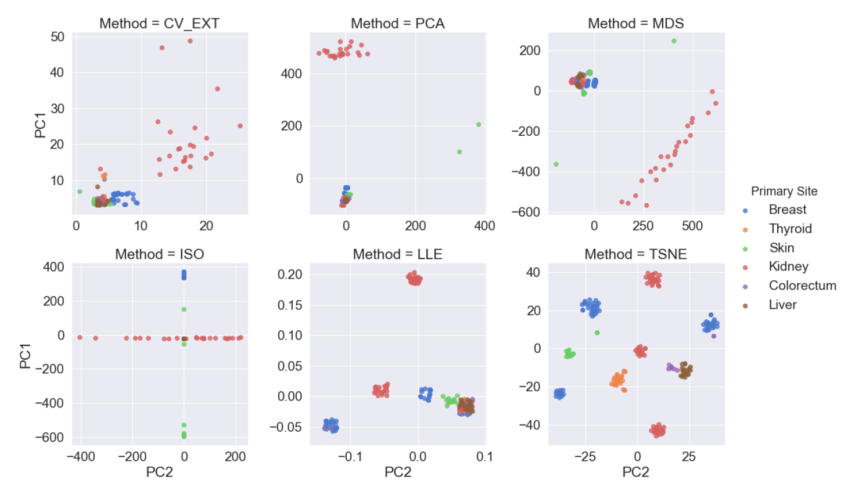
Step 3: Dimensionality reduction

Slide 18
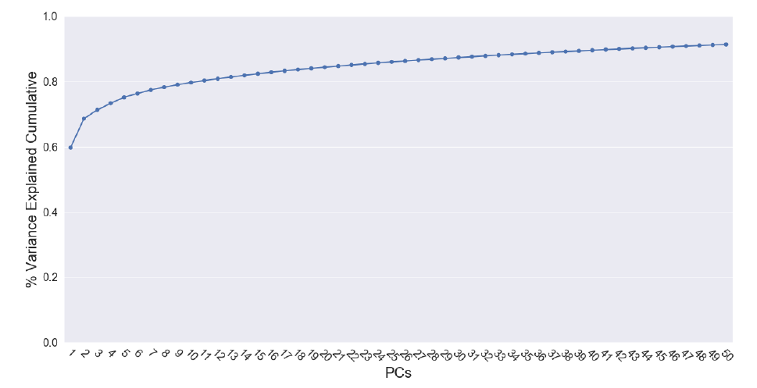
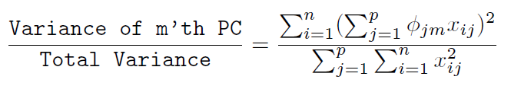
Step 3: Dimensionality reduction
The methods seeks to capture as much of the total variance in lower embedded dimensions
PCA:
97.1% of the total variance was captured in the lower 100 principal components.

Slide 19
Step 4: prediction

Slide 20
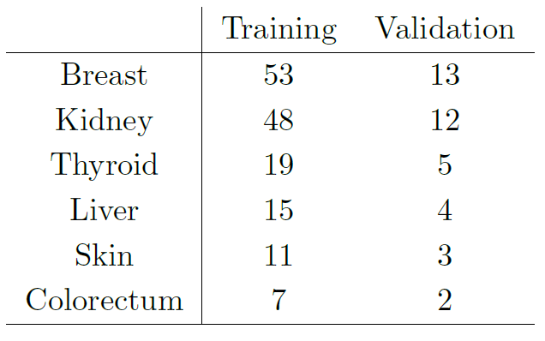
Step 4: Prediction
Training- and Validation-set:
80/20 split
Stratified (due to skewed distribution of samples)
Classification:
Logistic Regression
Random Forest
XGBoost
Support Vector Machine

Slide 21
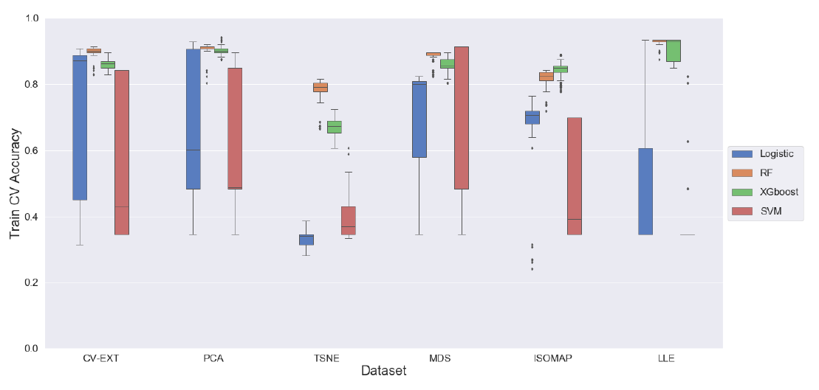
Training Accuracies
Methods were optimized using k-fold cross-validation (K = 5)
Tree-based methods performs best on average
Best score was XGBoost on PCA dataset (94.1%)

Slide 22
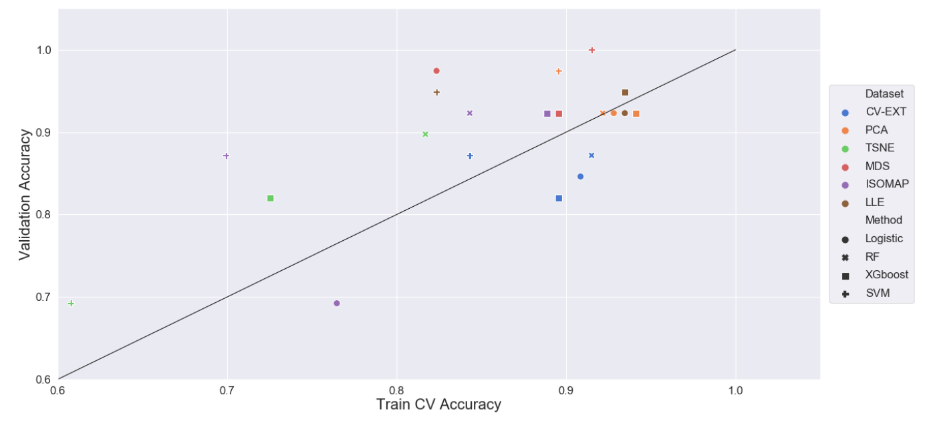
Validation Accuracies
Each best-performing method on each dataset was used to predict on the validation-set
24 points/predictions
3 main-objectives:
PCA & LLE
100% validation accuracy
CV-EXT dataset performs decent

Slide 23
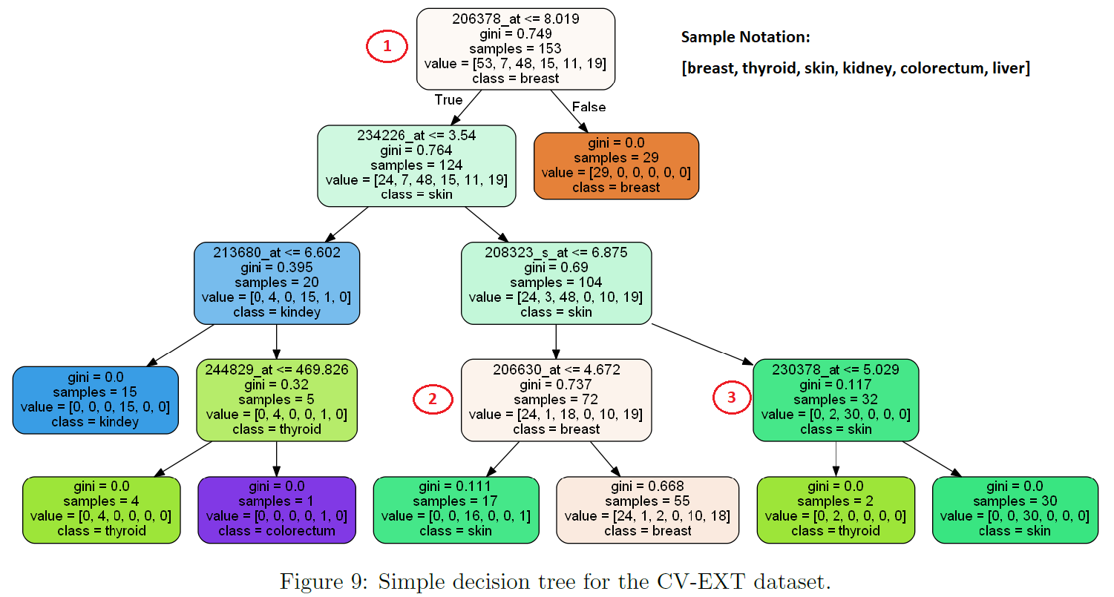
Inference of important genes

Slide 24
Conclusion & future aspects
Conclusion:
Project is concluded to have worked out successfully; the accuracies obtained here are very similar to literature (82-97%)
Validation accuracies around 91-94% on the most trustworthy models
The decision tree confirmed, that some of the genes/probes used to differentiate the primary sites previously have been mentioned in literature
Future aspects/different approaches:
Uncertainty regarding validation accuracies: Stochasticity involved in choosing training- and validation-set
Decision tree on original dataset (not on the lower dimensional CV-EXT) could yield even more interesting insights
Investigation of primary vs. metastasis sites (What am I predicting on?)
→ Due to skewed distributions

Slide 26
References

Slide 27
references
[1] Losa, F et. al. (2017), "SEOM Clinical Guideline on Unknown Primary Cancer", Clinical Guides in Oncology.
[2] Gauri R. Varadhachary & Martin N. Raber. (2014), "Cancer of Unknown Primary Site", New England Journal of Medicine.
[3] Economopoulou P & Mountzios G et. al. (2015), "Cancer of Unknown Primary origin in the genomic era: elucidating the dark box of cancer", Cancer Treat Rev.
[4] Hainsworth JD, Greco FA. (2014), "Gene Expression Proling in patients with carcinoma of unknown primary site: from translational research standard of care.", Virchows.
[5] Guantao, Zheng et. al. (2018), "HCMDB: The Human Cancer Metastatis Database", Nucleic Acids Research.

Slide 28
Appendix

Slide 29
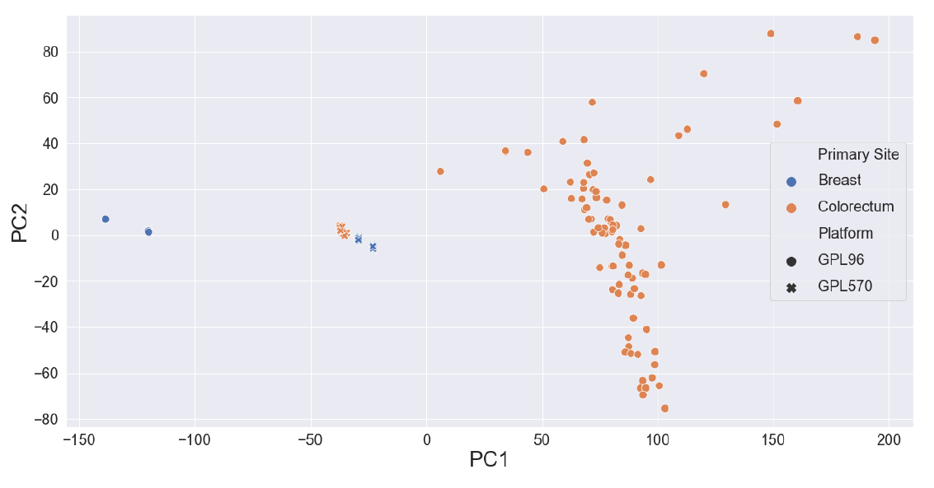
§1 beforehand normalized dataframe

Slide 30
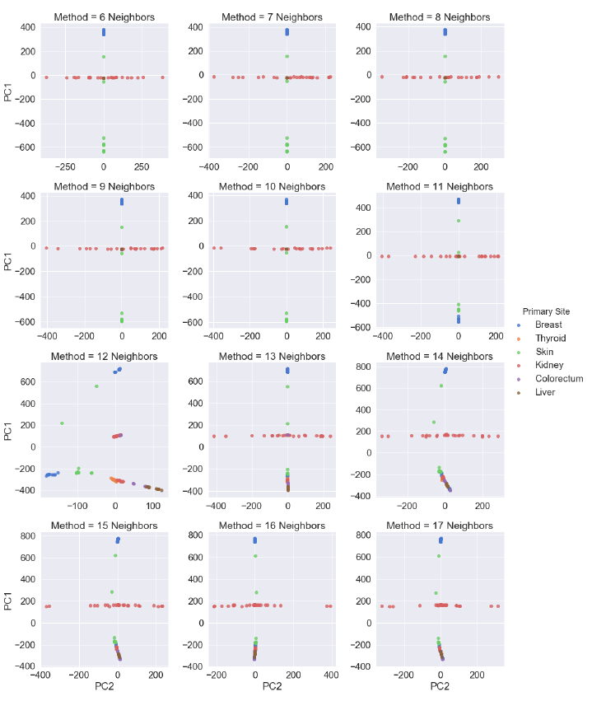
§2 isomap

Slide 31
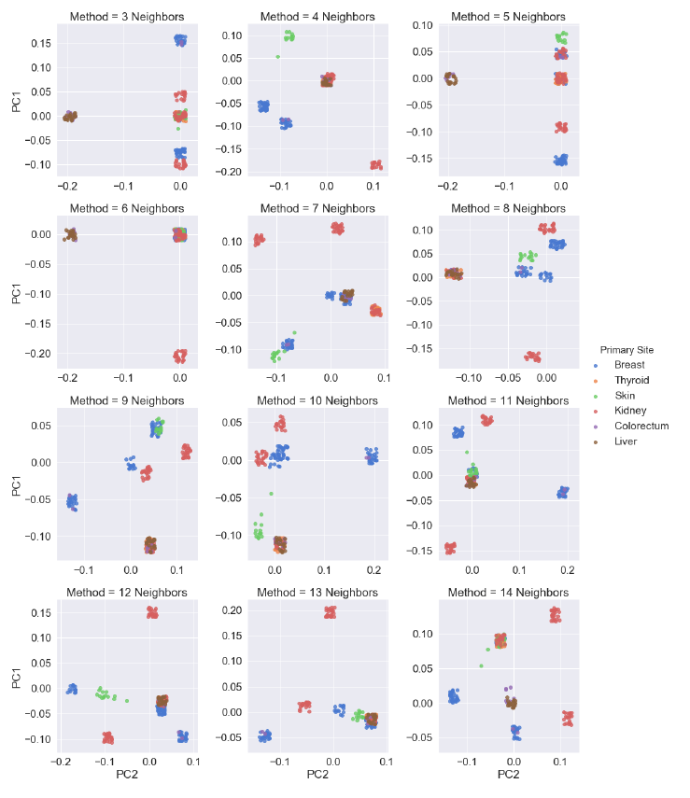
§3 locally linear embedding

Slide 32
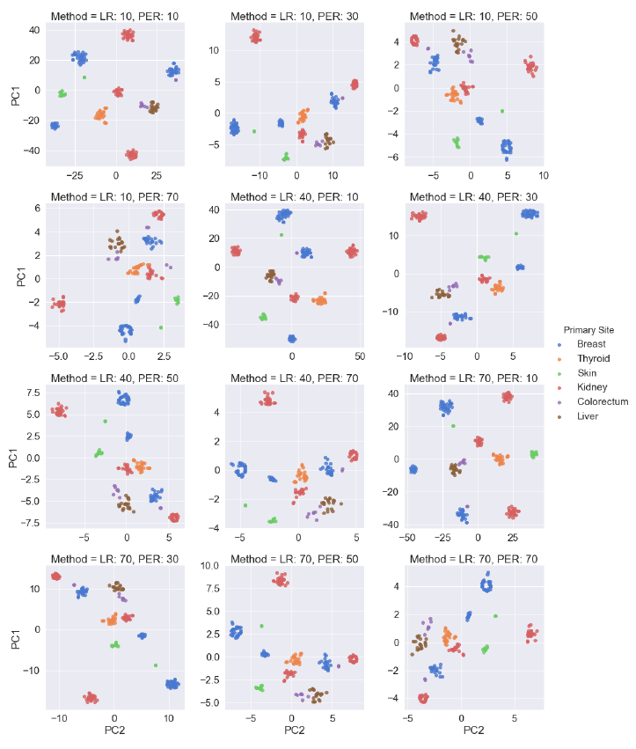
§4 t-SNE

Slide 33
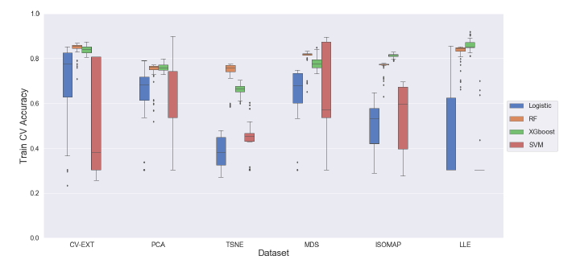
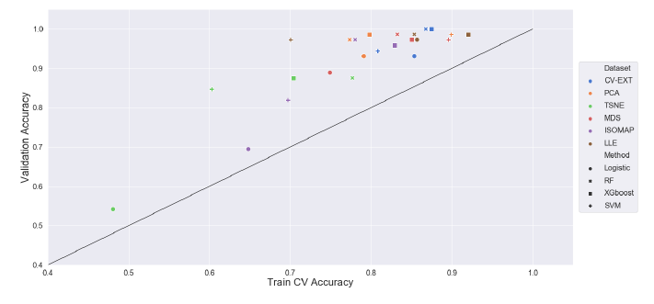
§5 results for merged dataframe

Slide 34
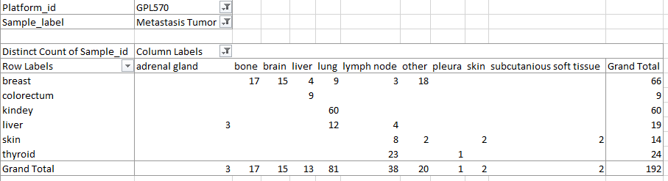
§6 primary vs metastasis (new)

Slide 35
methodology

Slide 36


Principal component analysis
Unsupervised dimensionality reduction method
Embedded features are principal components that are uncorrelated
Solved via an eigen-decomposition, that results in a loading-vector and variance of principal component
PVE (proportion of variance explained)

Slide 37
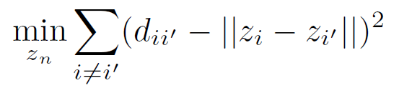
Multidimensional scaling
Unsupervised dimensionality reduction method
The key idea is to create a lower dimensional space, such that distances are preserved.
The formula to the right is minimized through the SMACOF-algorithm

Slide 38
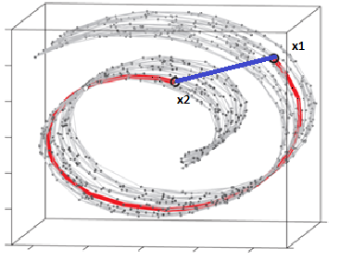
isomap
Unsupervised dimensionality reduction method
Extension of MDS, that maintains geodesic distances between the points
Computes the distances differently, by calculating the shortest path between them via a KNN-graph
Classic MDS is performed on the obtained distances

Slide 39
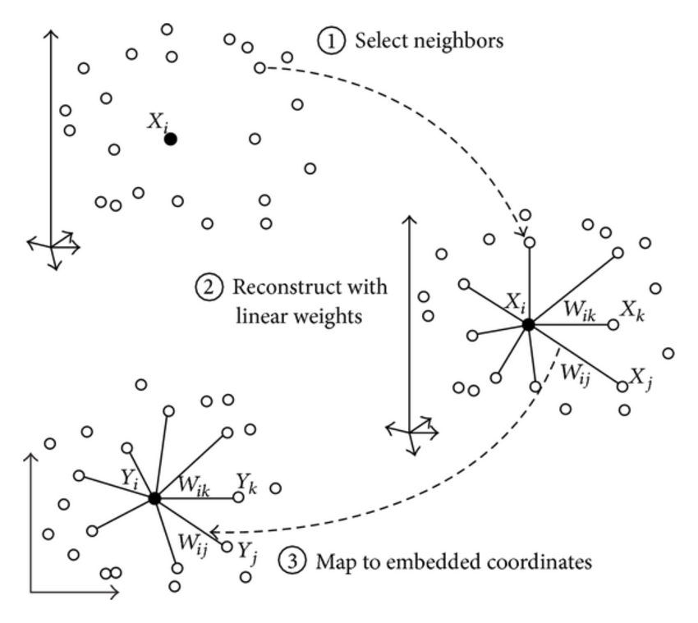
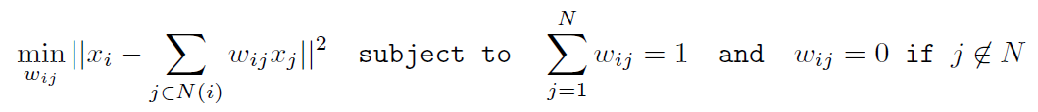
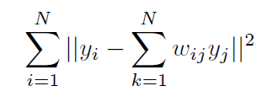
Locally linear embedding
Unsupervised dimensionality reduction method
Seeks to identify weights, such that each data point is approximated by a linear combination of neighboring points
Conceptually similar to “local regression”

Slide 40
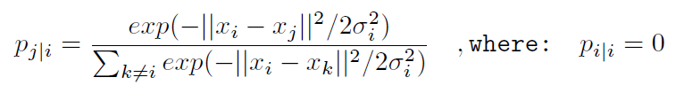

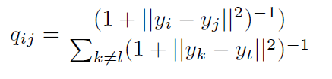

T-sne
High-dimensional space:
Unsupervised dimensionality reduction method
Converts distances to probabilities for datapoint i to choose j as its neighbor
Crowding problem is overcome by choosing t-distribution instead of Gaussian distribution
Low-dimensional space:
Minimizes distance between distributions:

Slide 41
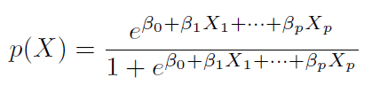

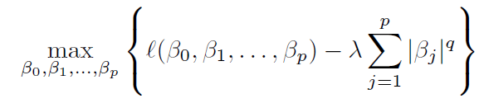
Logistic regression
Supervised parametric classification method
p(X) is the probability of the observation to be equal to the class set to 1 given the set of features.
Maximum-likelihood function is used to estimate the beta-coefficients.
Regularization is done to overcome the bias-variance tradeoff (lower variance)
Uses one-versus-rest (OVR) approach

Slide 42
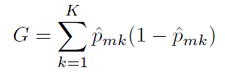
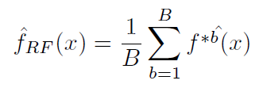
Random forest
Supervised non-parametric classification method
Decision-tree based: top-down greedy approach (recursive binary splitting) that uses Gini-index as cost-function
Random forest creates an ensemble of B decision trees made from bootstrapped samples (lowers variance)
Only uses a subset of features, m, in each split (lowers variance even further)

Slide 43

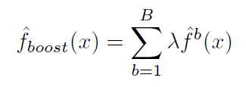
boosting
Supervised non-parametric classification method
Creates tree sequentially (not on bootstrapped datasets, but on modified versions of the dataset)
The λ-parameter is the learning rate, which is the quantity each newly constructed tree learns from the previous model.

Slide 44

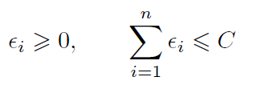
Support vector machines
Supervised non-parametric classification method
Idea is to separate the training observations into different groups using hyperplanes
M is the margin, and ε indicates where the training observation is located relative to the margin and hyperplane.
C controls the amount for which the margin can be violated (high means many observations are allowed to violate the margin/hyperplane)

